Slide 1
Problem Solving Using Area
Name
Class
Teacher
Term 3 Semester 2

Slide 2
Create your own front page
It needs to contain the following
My measurement interactive note book
Name
Class
Teacher’s name
Semester 2 Term 3
Page 1

Slide 3
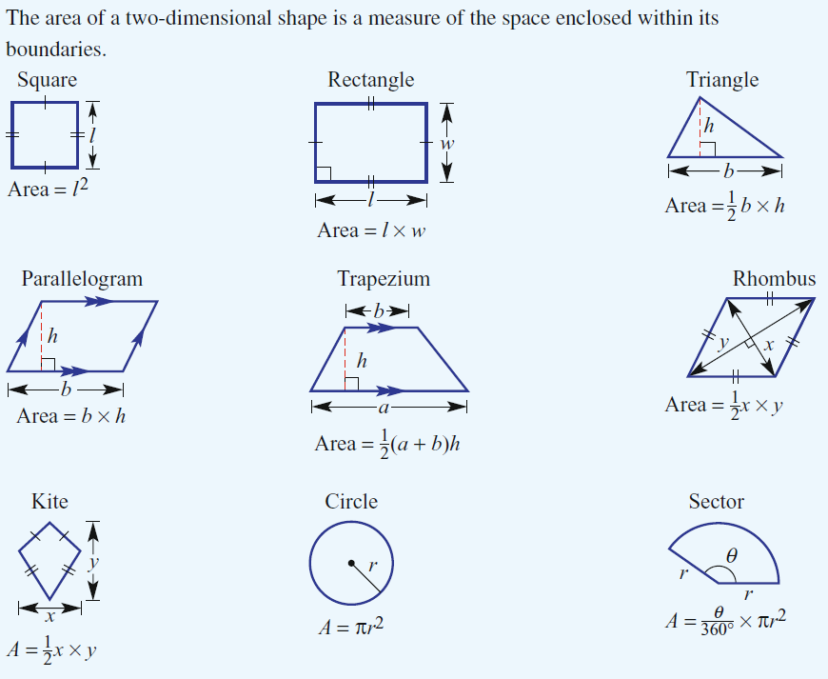
Date
Area - Reminder
EQ – Describe how to find the area of different shapes.
How do we find the area of 2 dimensional shapes?
5

Slide 4
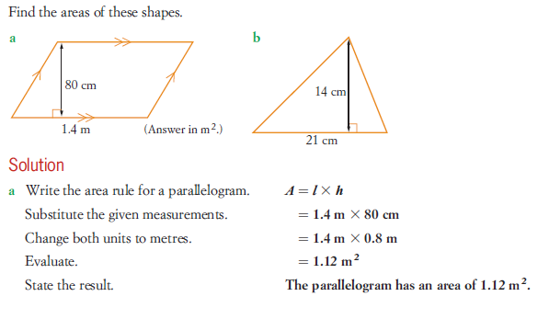
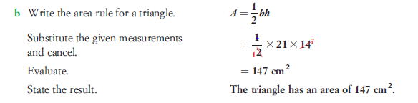
Example

Slide 5
Contents
Glossary or Formula Page
Page
Date
Description

Slide 6
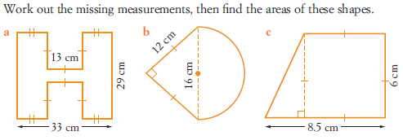
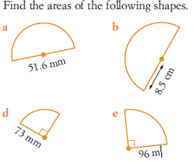
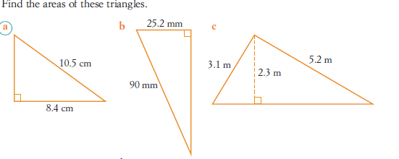
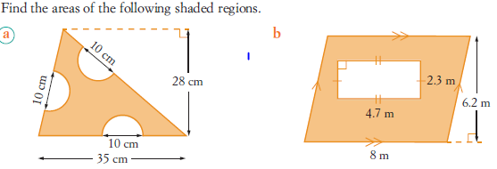
Task

Slide 7
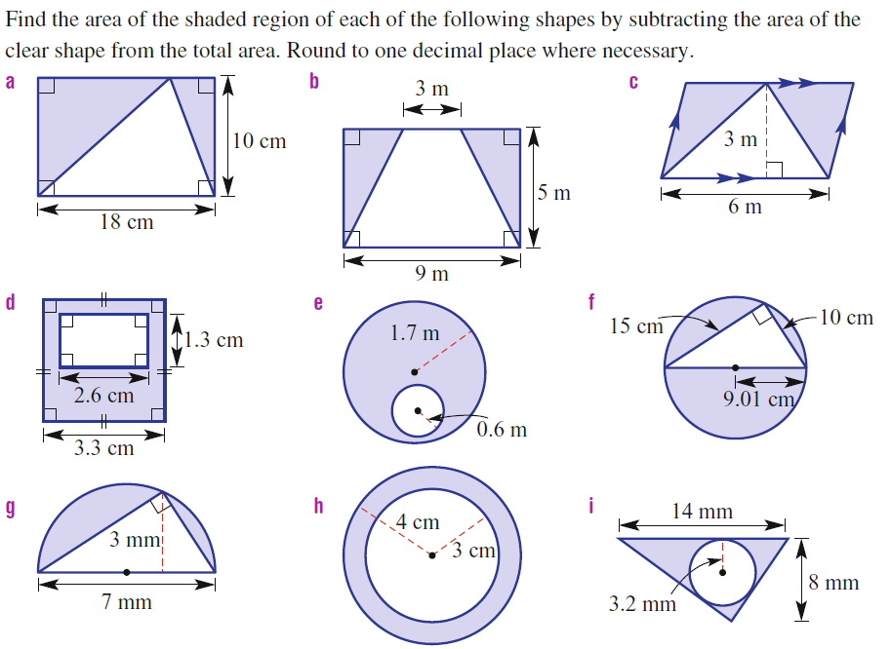
Answers

Slide 8
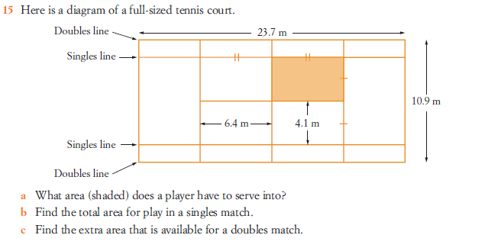

Slide 9
Notes Review
Date
Title
Essential question
Notes complete
Notes complete with colour and diagrams
Questions completed
Contents page filed in
Formula page filled in

Slide 10
Homework
Review your notes and write a summary answering the essential question.

